Slide 1
Deep
Learning
Minor
Youssef Ennali

Slide 2
Agenda
History of Artificial Intelligence (AI)
Why now?
Artificial intelligence
Machine learning
Algorithms
Deep learning
Neural networks
Landscapes
Short recap
Questions?

Slide 3
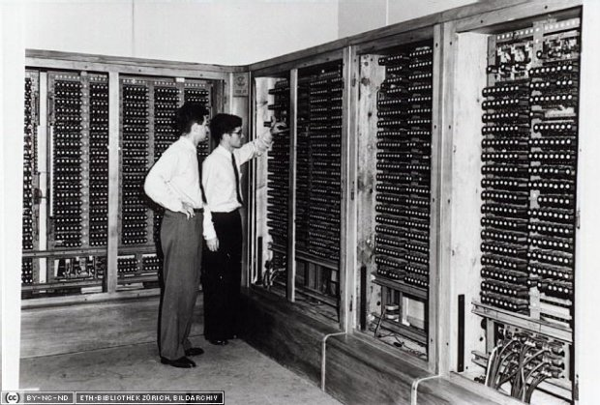
A brief history…
Since the emergence of the first computer in the 1950s academic exploration of the concept started
It only took off in recent years… why?

Slide 4

Access to hardware: Moore’s law
Storage and processing of huge amount of data

Slide 5
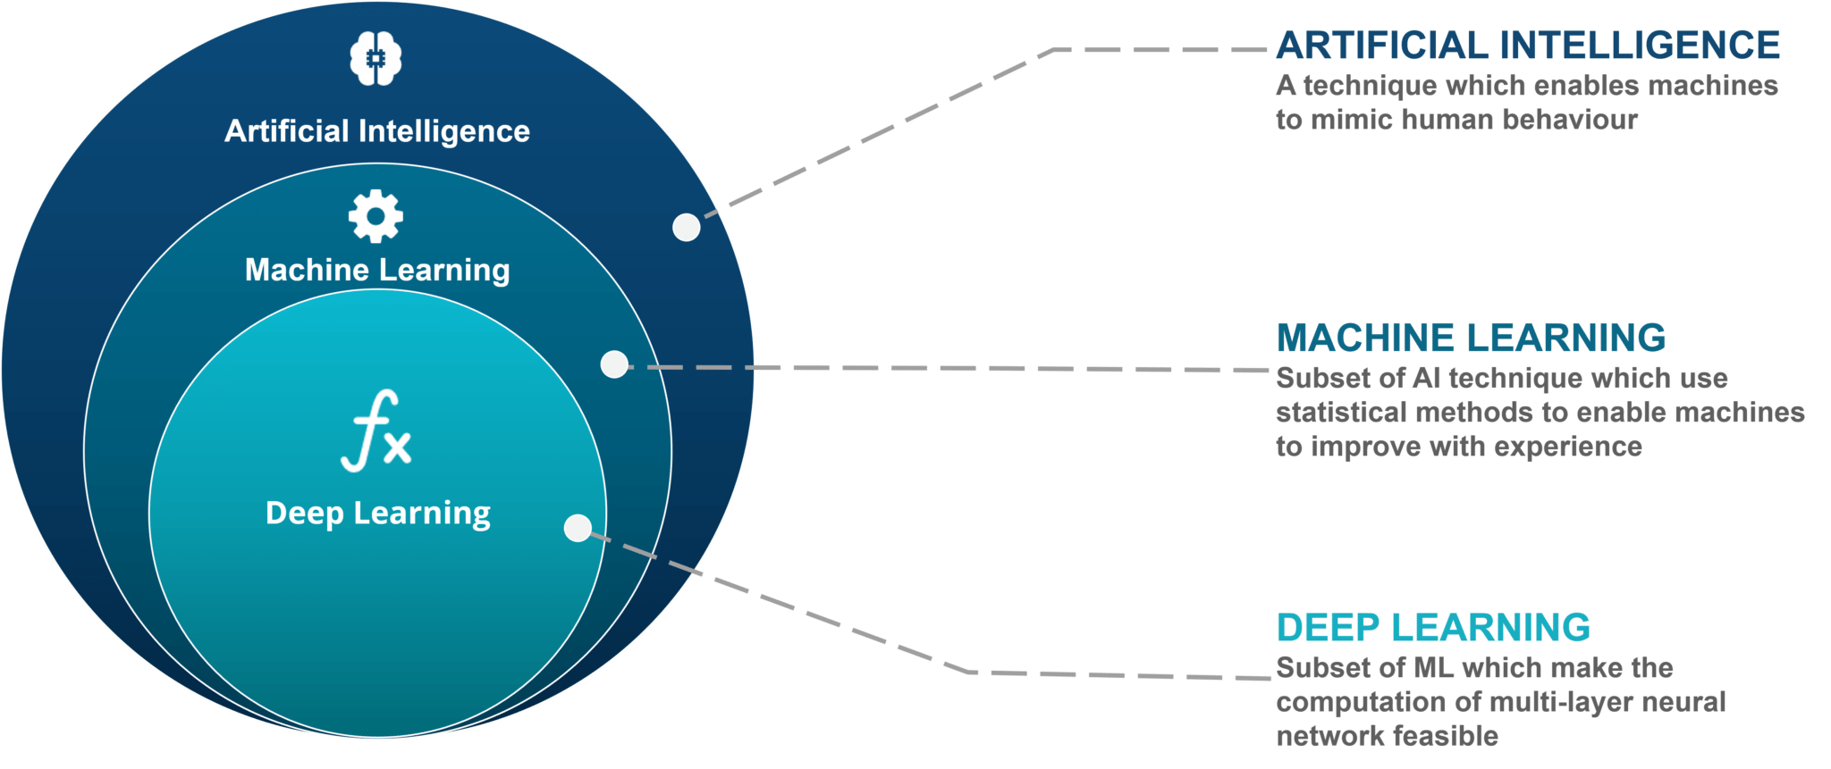
Artificial Intelligence, Machine Learning and Deep Learning

Slide 6

Short introduction

Slide 7
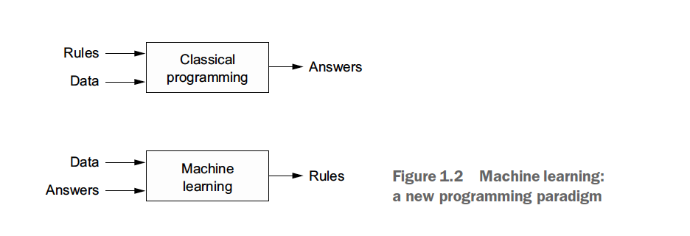
Machine Learning
Algorithms
(Artificial Neural Networks / ANN)

Slide 8
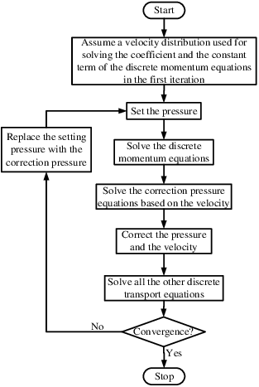
What are algorithms?
An algorithm is a set of instructions for solving a problem or accomplishing a task. ... Every computerized device uses algorithms to perform its functions in the form of hardware- or software-based routines. (source: Investopedia.com)
ANN: is a series of algorithms for recognizing relationships in a set of data

Slide 9
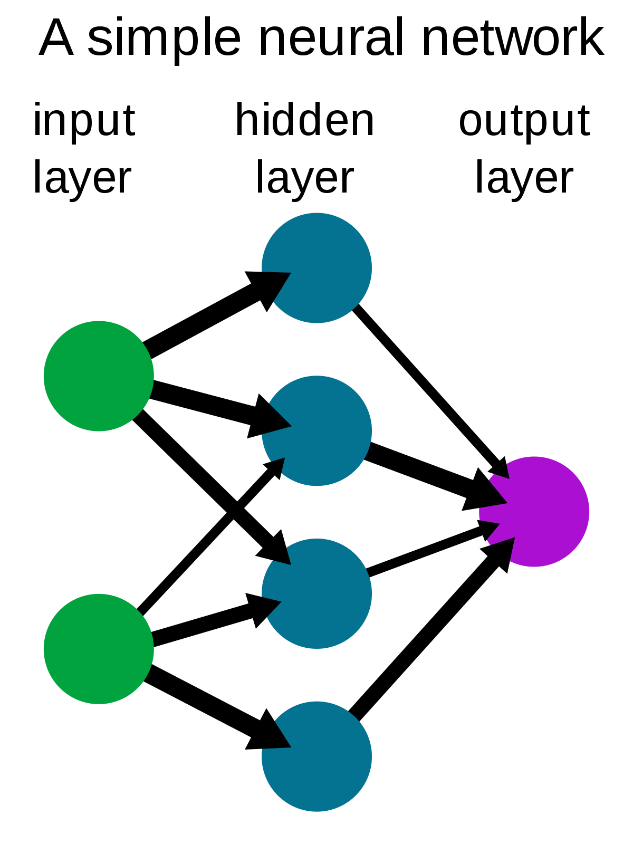
Machine Learning: what are algorithms?

Slide 10
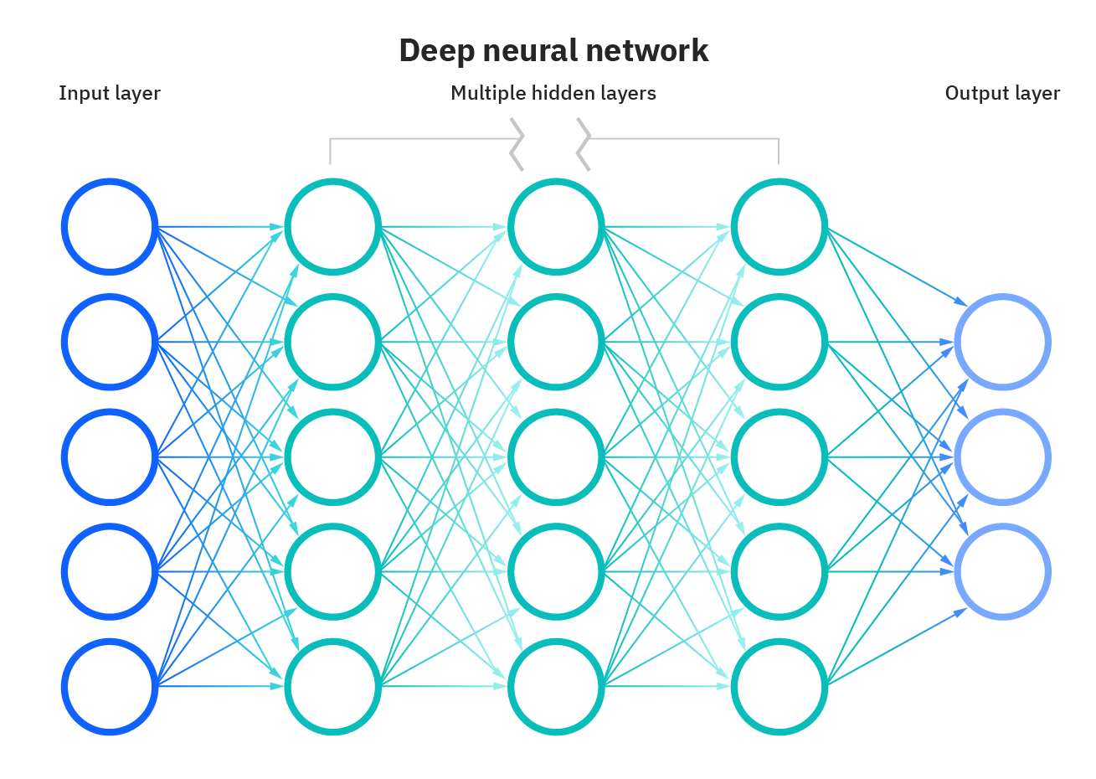
It becomes ”deep” if it contains 2 or more hidden layers
Deep learning: what are neural networks (sometimes referred to as a deep neural network (DNN)?
Multiple hidden layers consisting of nodes
Each their own task
Called a neural network since it mimicks the human brain (neuro biology)
Backpropagation algorithm: will be discussed in the next lecture

Slide 11
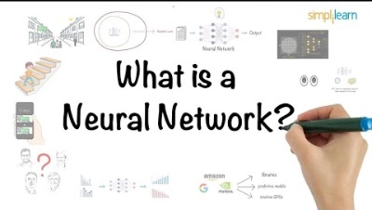
Short video on neural networks

Slide 12
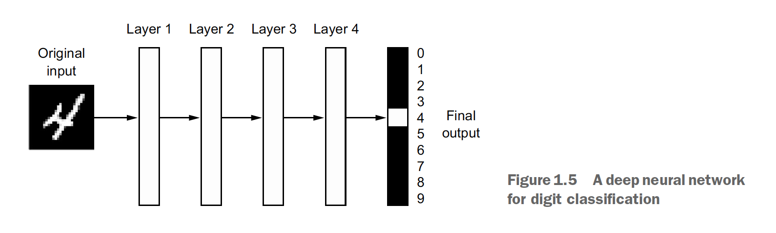
Deep learning (1/2)

Slide 13
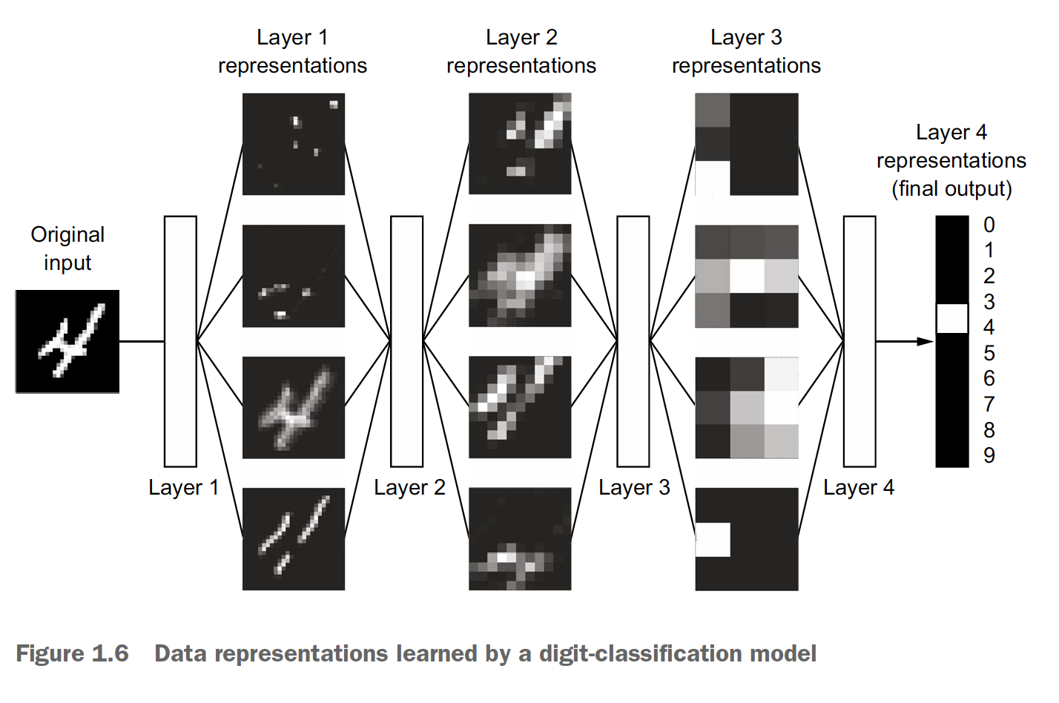
Deep learning (2/2)

Slide 14
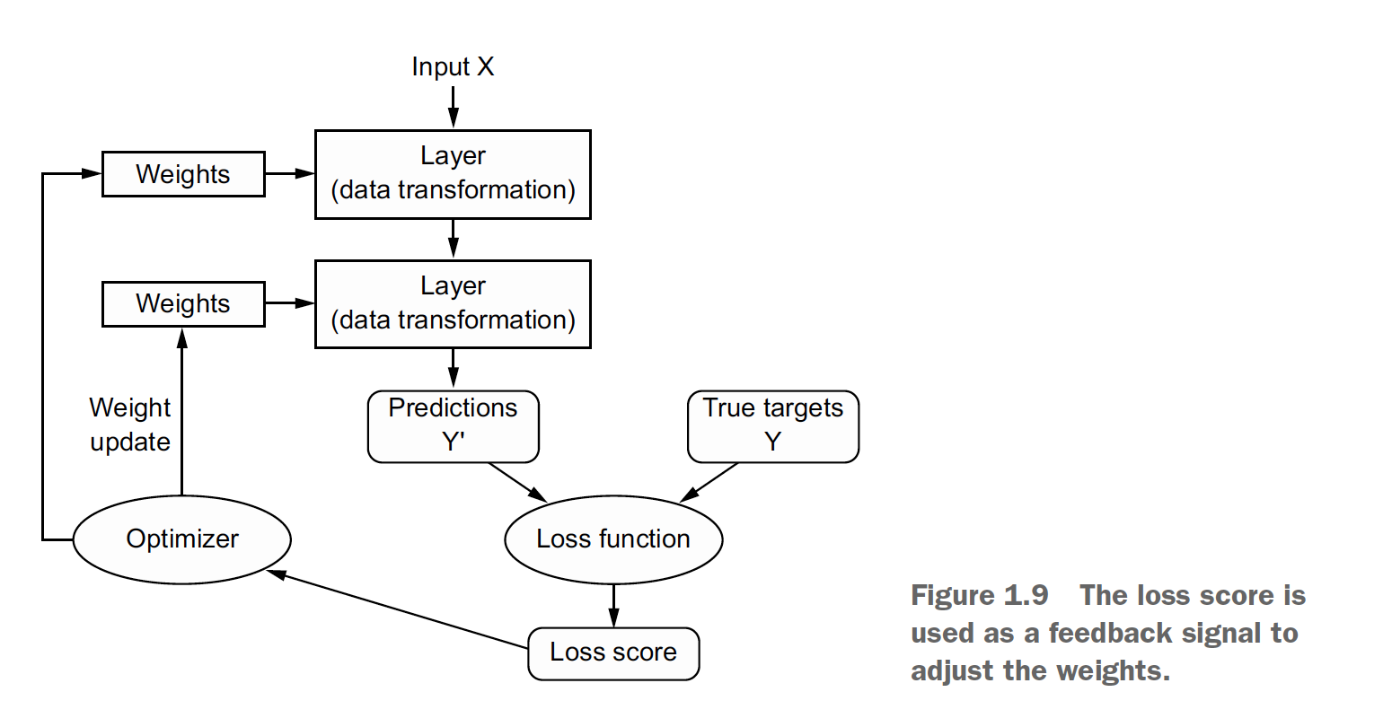
Weights (parameters), layers, predictions, true targets, loss function and optimizer

Slide 15



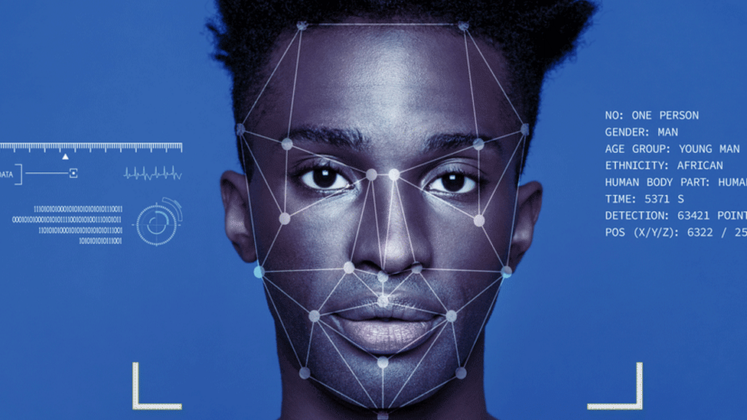
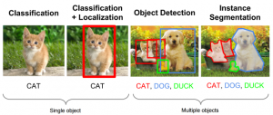
Some examples
Machine learning:
Image recognition
Speech recognition
Medical diagnosis
…
Deep learning:
Virtual assistants
Chat bots
Translations
Facial recognitions
…

Slide 16
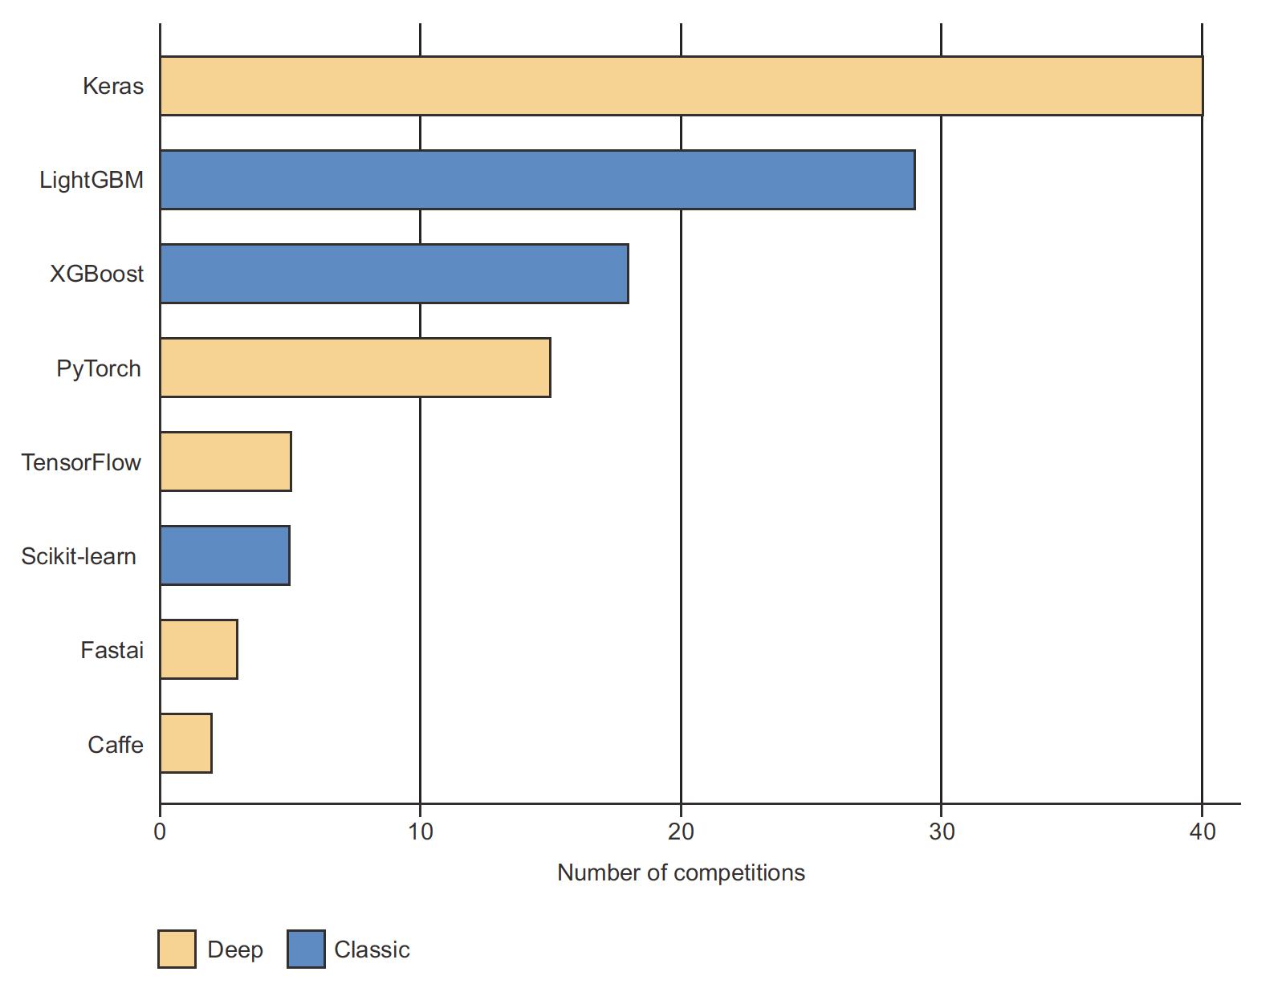
Landscapes: frameworks machine vs. deep learning (2017)

Slide 17
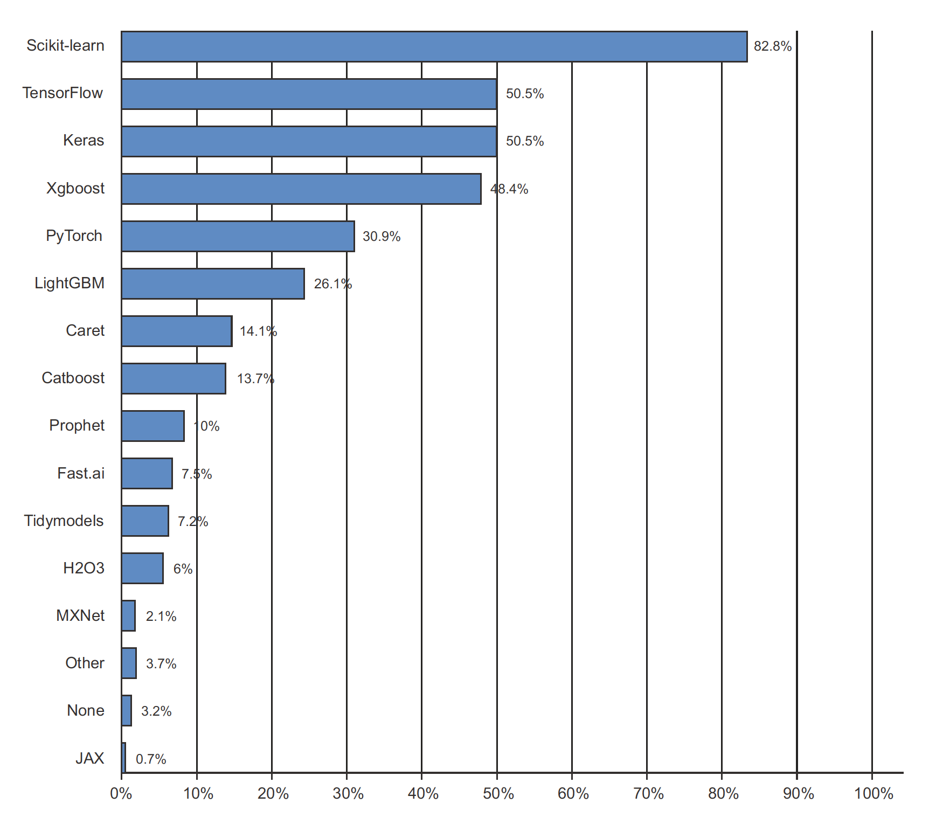
Landscapes: frameworks (2020)

Slide 18
Short recap
How are Artificial Intelligence, Machine Learning and Deep Learning related?
What are the biggest differences between Machine Learning and Deep Learning?
What are algorithms?
What are neural networks?
What kind of layers does a neural networks consist of?
What is a loss function?
Why an optimizer?

Slide 19

Questions?

